Slide 1

Olympiades FANUC Ingénieur
Équipe CentraleSupelec
CARVALHO BÜRGER Karoline
DE JESUS RODRIGUES Tiago
ELLER CRUZ Rafael
NOGUEIRA Rafael Accácio

Slide 2

Summary:
1 – Problem description;
2 – Solution description;
2.1 – Robot choice;
2.2 – Robot and fixtures positioning;
2.3 – Robot trajectory and programming;
2.4 – Robotic cell inputs and outputs;
2.5 – Operational safety considerations;
3 – Results
4 – Conclusion
Notes:
2

Slide 3
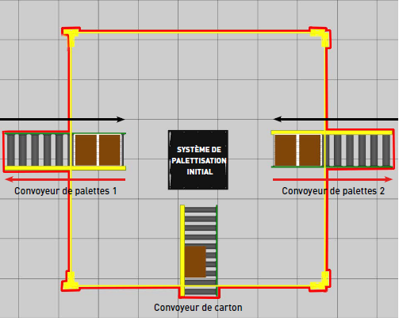
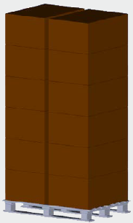
1 – Problem description
Project objective:
Optimize the present distribution of a palletizing system of a factory
Original Surface
Pallet and boxes

Slide 4
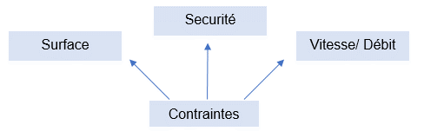
1 – Problem description
Main constraints to be followed:
Reduce by 2 the original surface (3.6 x 3.6 m)
Data provided: dimension of the fixtures, velocity, flow
Safety: DCS

Slide 5
2 – Solution description
2.1 – Robot choice;
2.2 – Robot and fixtures positioning;
2.3 – Robot trajectory and programming;
2.4 – Robotic cell inputs and outputs;
2.5 – Operational safety considerations.

Slide 6
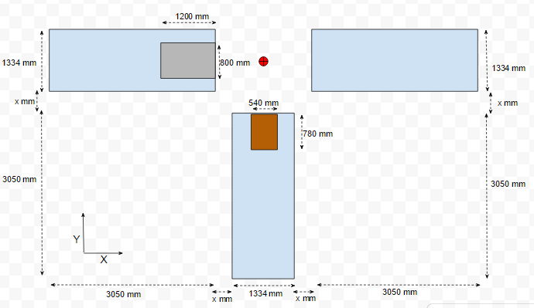
2.1 – Robot choice
Robot application => Palletizing;
Payload => Gripper + Box ( 70 kg )
Range of action
1812.19 mm

Slide 7
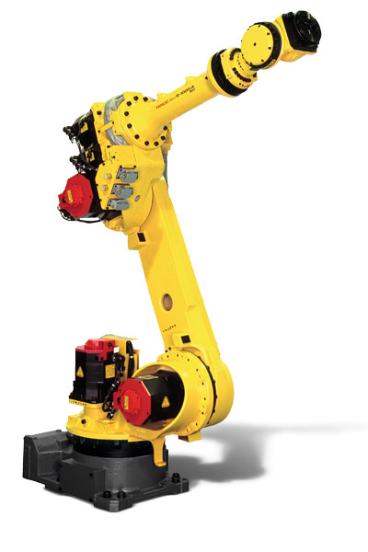
2.1 – Robot choice
Production throughput → 411 products per hour;
one box each 8.76 seconds;
The chosen one…
R-1000iA/80H
Number of axis | 5
Reach | 2230 mm
Load capacity | 80 kg

Slide 8
2 – Solution description
2.1 – Robot choice;
2.2 – Robot and fixtures positioning;
2.3 – Robot trajectory and programming;
2.4 – Robotic cell inputs and outputs;
2.5 – Operational safety considerations.

Slide 9
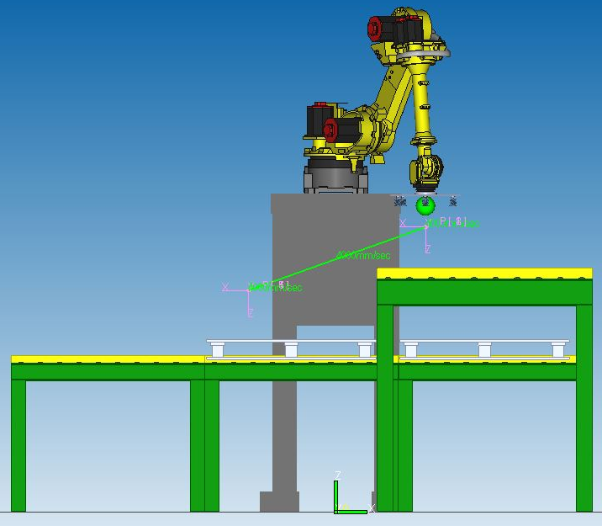
2.2 – Robot and fixtures positioning
Problematic: size of the conveyors.
Solution:
verticalization!

Slide 10
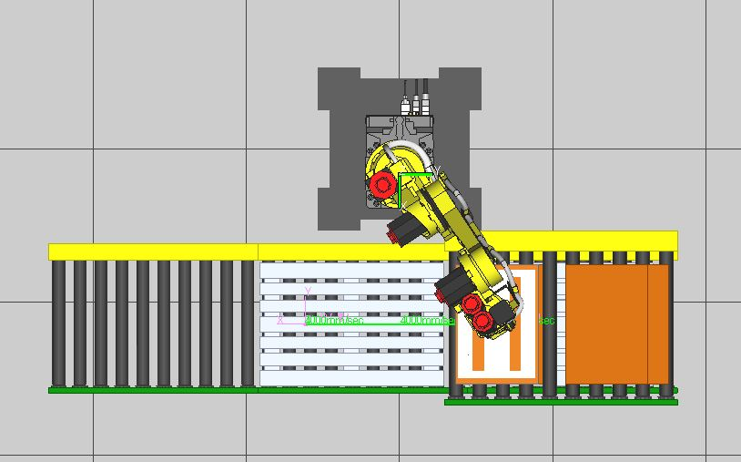
2.2 – Robot and fixtures positioning
3 – Charged pallets are removed.
2 – Boxes are stacked in pallets.
1 – Boxes arrive and are taken; empty pallets arrive.

Slide 11
2.2 – Robot and fixtures positioning
2250 mm
454 mm

Slide 12
2 – Solution description
2.1 – Robot choice;
2.2 – Robot and fixtures positioning;
2.3 – Robot trajectory and programming;
2.4 – Robotic cell inputs and outputs;
2.5 – Operational safety considerations.

Slide 13
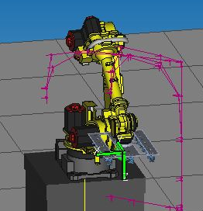
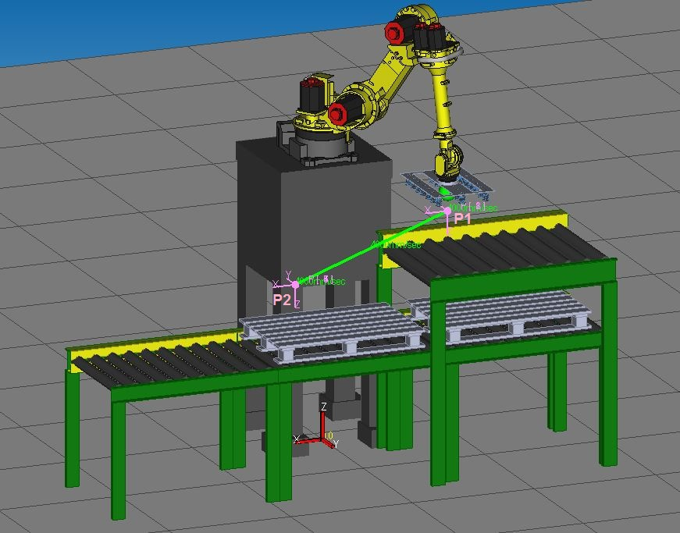
2.3 – Robot trajectory and programming
Frames
Tool frame
User frame

Slide 14
2.3 – Robot trajectory and programming
Register points
Offset

Slide 15
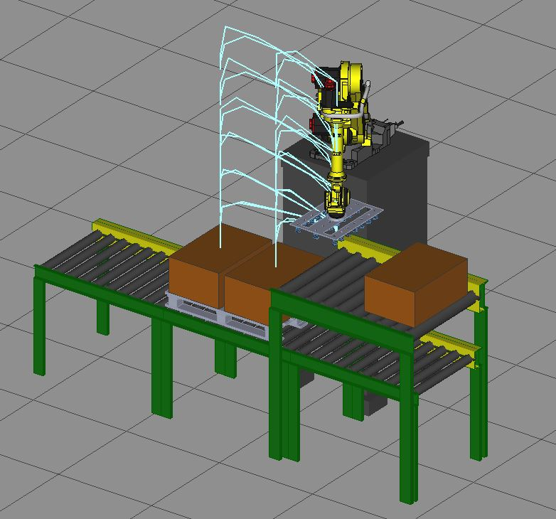
2.3 – Robot trajectory and programming
Trajectory

Slide 16
2.3 – Robot trajectory and programming
Robot programming
MAIN
Prisedepose_Conv
Two programs:
Empty gripper
Gripper + box
Important issues:
Payload

Slide 17
2 – Solution description
2.1 – Robot choice;
2.2 – Robot and fixtures positioning;
2.3 – Robot trajectory and programming;
2.4 – Robotic cell inputs and outputs;
2.5 – Operational safety considerations.

Slide 18
2.4 – Robotic cell inputs and outputs
Inputs: five sensors are necessary;
Outputs: four actuators are necessary.

Slide 19
2 – Solution description
2.1 – Robot choice;
2.2 – Robot and fixtures positioning;
2.3 – Robot trajectory and programming;
2.4 – Robotic cell inputs and outputs;
2.5 – Operational safety considerations.

Slide 20
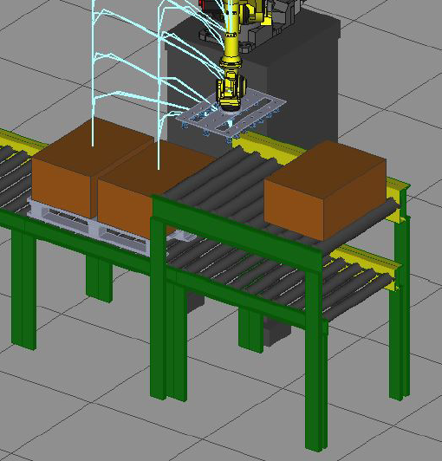

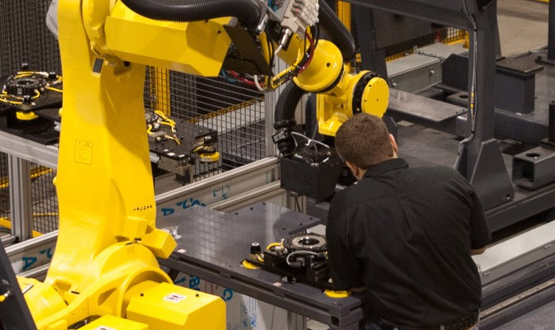
2.5 – Operational safety considerations
Risk assessment
Access to the pallets
Falling objects
Maintenance

Slide 21
2.5 – Operational safety considerations
First Solution: Fence

Slide 22
2.5 – Operational safety considerations
Problems:
Lack of protection
Fence area

Slide 23
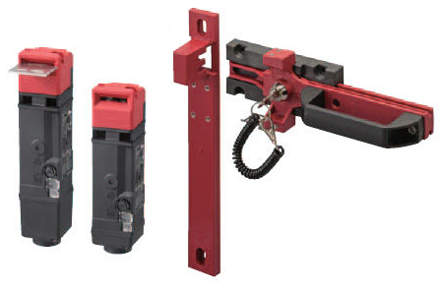
2.5 – Operational safety considerations
Solution:
Dual Check Safety Cartesian Position Check;
Interlock Switch.

Slide 24
3 – Results & Performance
3.1 – Security;
3.2 – Surface;
3.3 – Production Throughput;
3.4 – Budget.

Slide 25
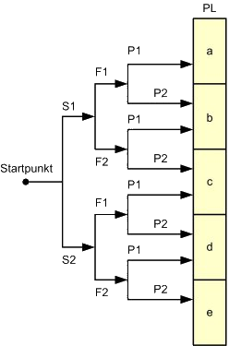
3.1 – Security
Compliance with ISO 13849-1:

Slide 26
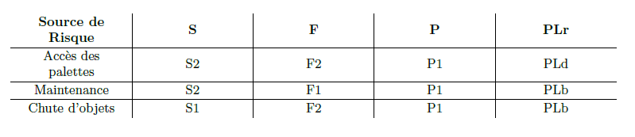
3.1 – Security
Compliance with ISO 13849-1:

Slide 27
3.1 – Security
Compliance with ISO 13849-1:
Function name | Standard/Optional | ISO13849-1/IEC61508
Joint Position Check Function | Option A05B-2600-J567 | Category 3 PL d SIL 2

Slide 28
3 – Results & Performance
3.1 – Security;
3.2 – Surface;
3.3 – Production Troughput;
3.4 – Budget.

Slide 29
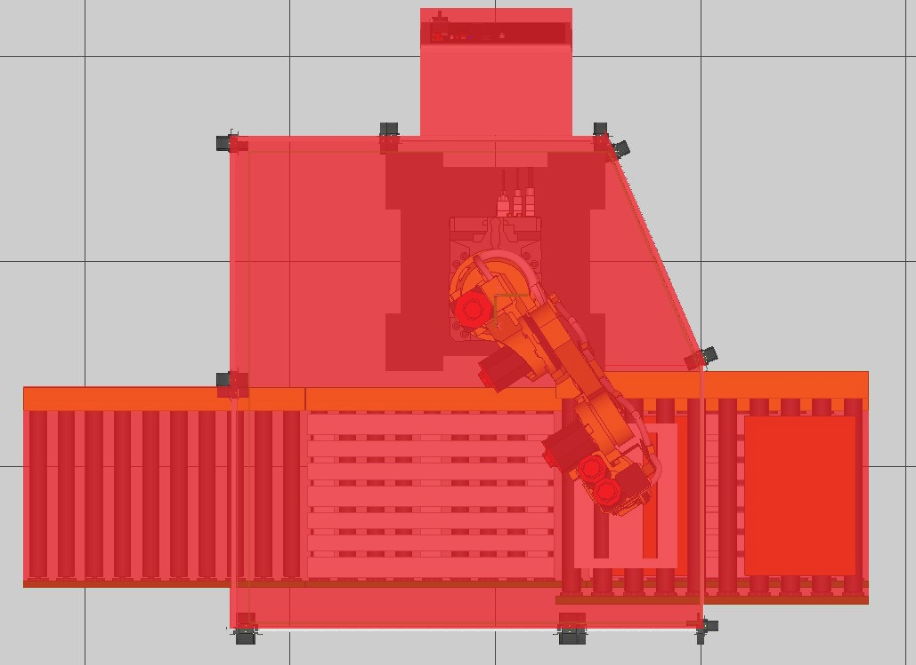
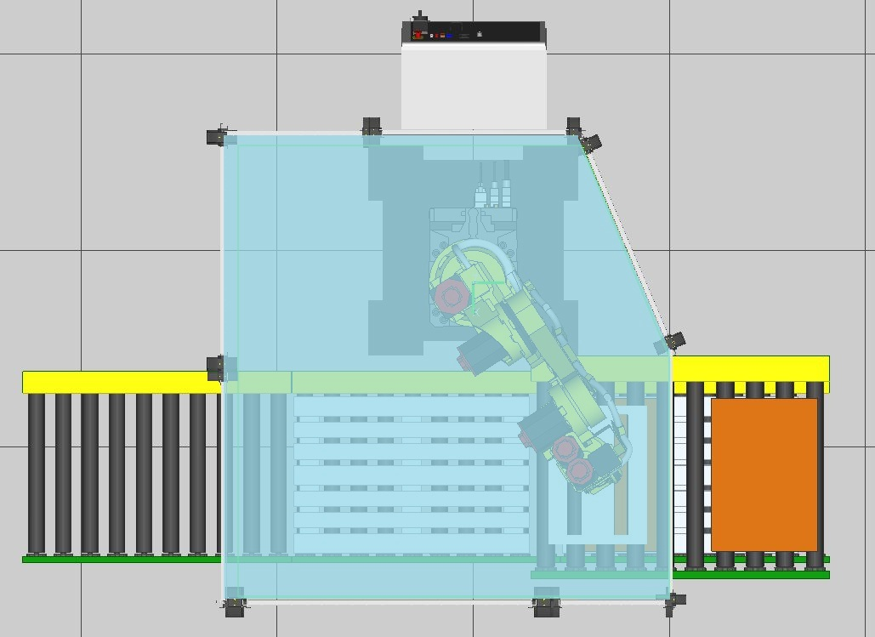
3.2 – Surface
Total Area: 7.47 m²
Equivalent to 57.61% of initial area
Working surface: 5.33 m²
Equivalent to 41.14% of initial area

Slide 30
3 – Results & Performance
3.1 – Security;
3.2 – Surface;
3.3 – Production Troughput;
3.4 – Budget.

Slide 31
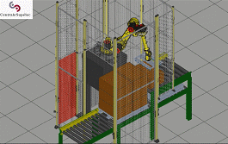
3.3 – Production Throughput
720 boxes / hour *
About 75% more than the original cell throughput

Slide 32
3 – Results & Performance
3.1 – Security;
3.2 – Surface;
3.3 – Production Throughput;
3.4 – Budget.

Slide 33
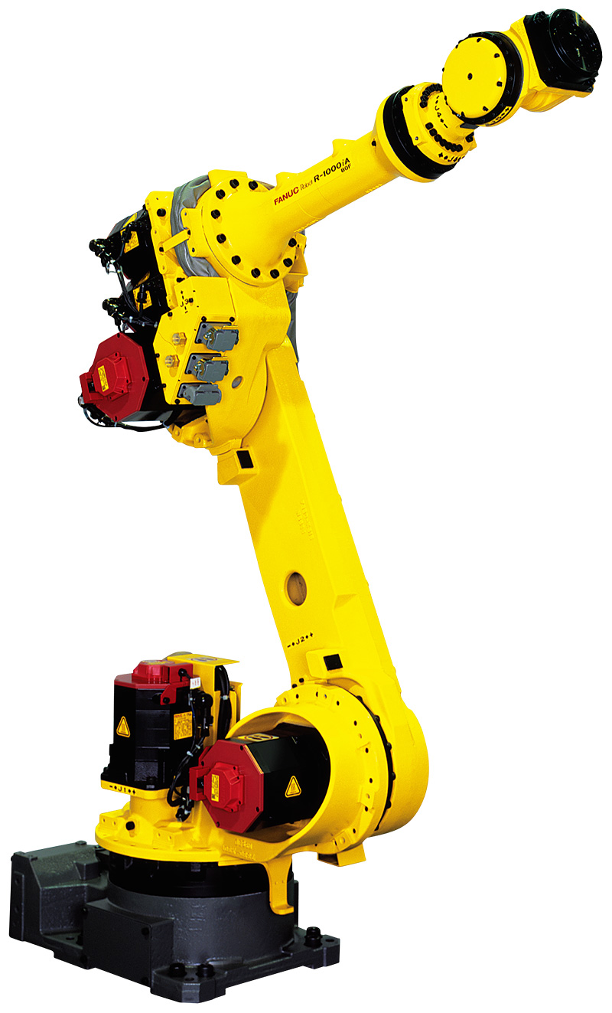
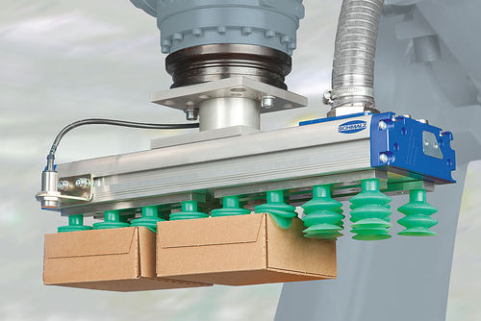
3.4 – Budget
Robot R-1000iA/80H + R-30iB Controller and DCS Module
Around 45000 + 2000 €
Suction Gripper
Around 700 €
Merely illustrative

Slide 34
3.4 – Budget
Elements | Price
Robot R-1000iA/80H | 45000 €
DCS Module | 2000 €
Suction Gripper | 700 €
Total | 47700 €

Slide 35
4 – Conclusion
Faster than expected
Considerably cheap
Less than 50% of initial surface
Software maintainability

Slide 36
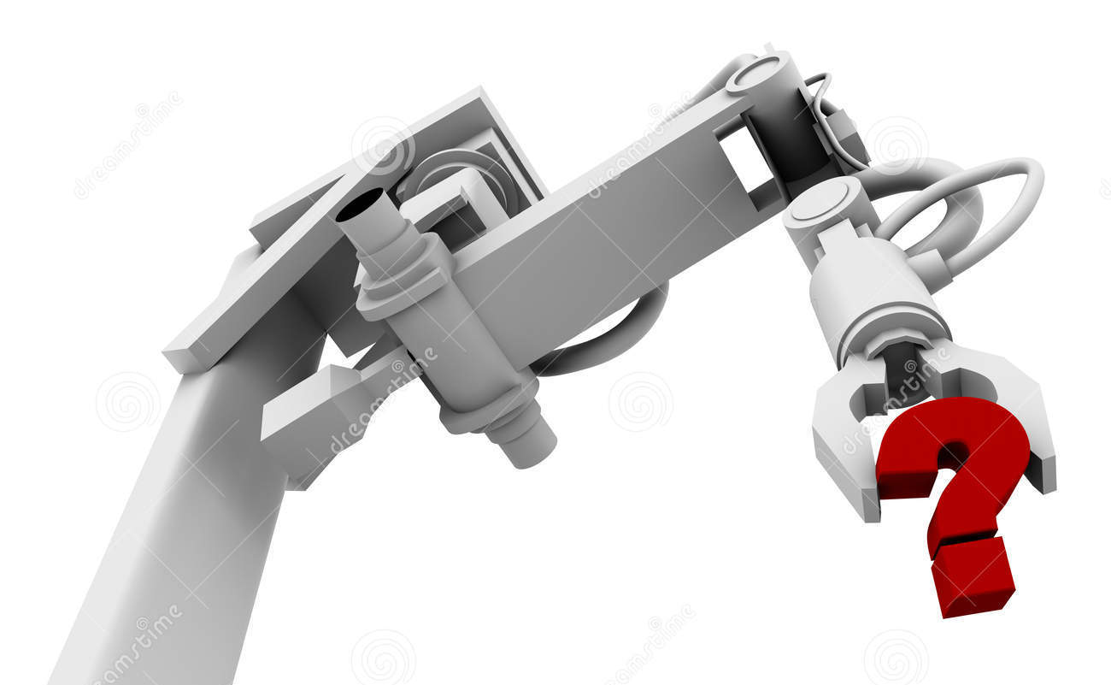
Thank you for your attention!
Any question?

